Slide 1
An Extensive Approach for Non-Instrusive Load Diaggregation With Smart Meter Data
2018
TRANS
Smart Grid
Weicong Kong, Zhaoyang Dong, Jin Ma, David J.Hill, Fengji Luo, University of Sydney
Junhua Zhao, the Chinese University of Hong Kong

Slide 2
NILD
menu
Abstract/Intro
Modelling
Conclusion
Approach
Content
Simu
Framework

Slide 3
Introduction
/01
Appliance Level Modelling importance,
NILM signature,
Existing approach

Slide 4
Enable public awareness of energy efficiency with meter data
ES
DR
Renewable
Energy Storage
Demand Response
Renewable
Energy internet
more efficient DR program
coordinate renewable energy integration
Notes:
电器模型对于电力公司的需求分析，电网的能源存储以及分布式新能源发电接入（这三者都与消费者强相关）有着非常重要的作用；
电器模型推导出的消费数据，才能真正引起消费者的兴趣；
但是现状现实存在的AMI限于户级或房间级，还不能直接获取到电器级消费数据。
因此，本文的工作在于，从智能电表数据中提取分析出准实时的电器级数据，最终的目标是借此为电力公司设计更高效的DR程序，来协调能源存储单元和新能源发电站，
最终实现公众对能源有效性的感知。

Slide 5
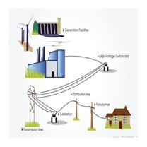
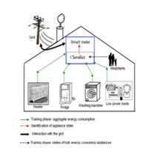
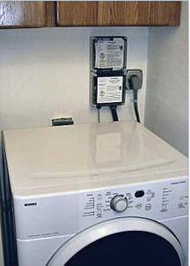
Scenarios
Grid
DR result
storage
renewable
A clothes dryer using a demand response switch to reduce peak demand
Coordination.
NILD
Focus.
https://en.wikipedia.org/wiki/Demand_response
Notes:
电网包括存储能量、新能源；
NILD非侵入式负荷分解；
通过DR需求响应数据来协调电网和家庭中每个用电设备的情况；
最终实现整个电力系统的宏观系统和微观系统的高效运行。
也就是这条在一个相对小的时间内正常负荷和理想负荷越来越接近。

Slide 6
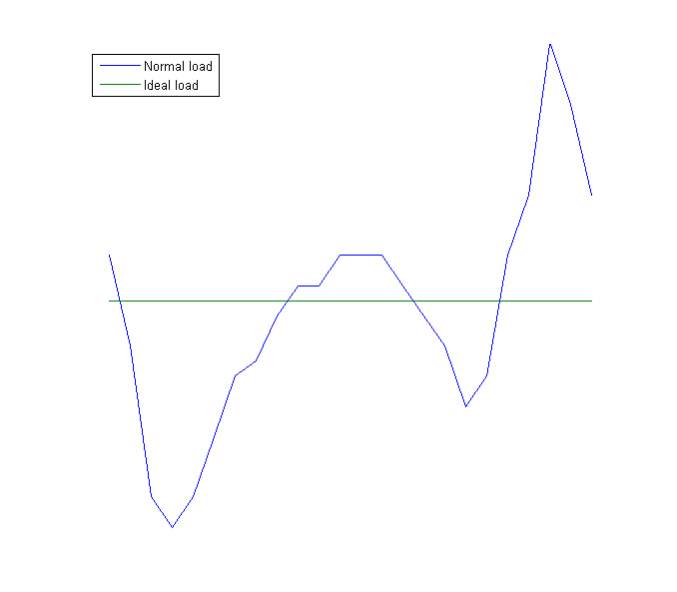
Demand Response Curve
DR
描述需求响应的先进性

Slide 7
NILD history
REDD,dataset
MIT
NILM
MIT
1992
2011-2014
PowerBlade,physical submeter
Berkeley
2015
NILD,
this paper
NILM
MIT
2018
2019
Notes:
NILM历史其实还是漫长了，
从1992年MIT的hart教授开始，到2019年MIT依然有人发这方面的文章，以及做相关的系统；
以及berkeley在2015年前后在侵入式负荷监控方面有一些成果；

Slide 8
Rate
1
2
3
1 per 30min
1 per min
1 per 5 second
1hz
50hz
8000hz
4
5
6
Notes:
1、采样率集中在1hz以下；
2、当然相关的研究可以覆盖到30分钟一次，也可以到8000hz的

Slide 9
Nyquist–Shannon sampling theorem
Approach
event.non-event.
Technology
Chip.Hardware. wide deployment
Cost
Communication/Computing COST
Rate
Sampling rate.

Slide 10
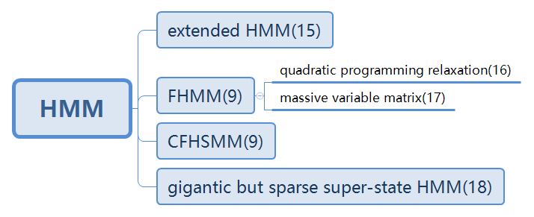
HMM for NILM

Slide 11
Contirbutions
Propose an iterative k-means method to fit HMM parameters
Instead of training individual appliances based on days or weeks of sub-metered observation
Propose a segmented integer quadratic constriant programming
Unlike on high frequency data
Give a potential extensive architecture
To integrate the NILM framework with the existing smart meter infratucture

Slide 12
Modelling
/02
Appliance Level Modelling importance,
NILM signature,

Slide 13
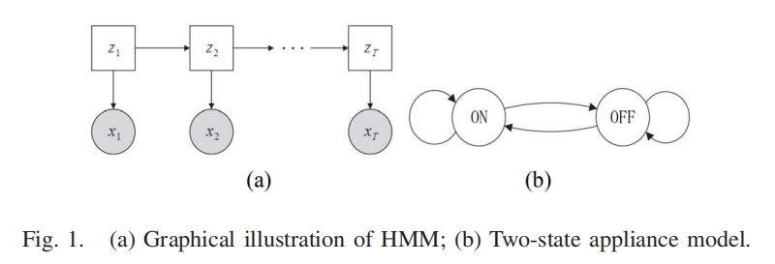
Modelling for individual appliance
Prior probability vector of initial state
which represents the probality with which the appliance is at state i at the first time step.
A complete HMM is formulated by three sets of parameters:
Transition matrix A
whose element Ai,j represents probability with which appliance will transit state from i at t-1 to j at t:
appliance state Z={1,2,...,K}.
corresponding observation x={x1,x2,...,xt}.
Emission vector
ei means the emission distribution of the ith hidden state.

Slide 14
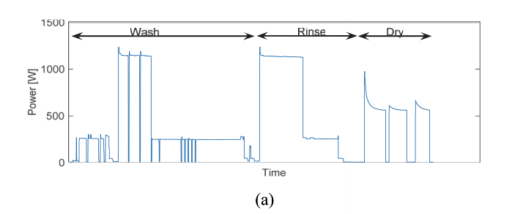
Multi state K appliance
If K=2
If K=4
Simplified piece wise constant profile does not represent the dishwater adequately
from histogram analysis, 4 distinct clusters are obvious.
……
Pratical power consumption
original dishwater profile

Slide 15
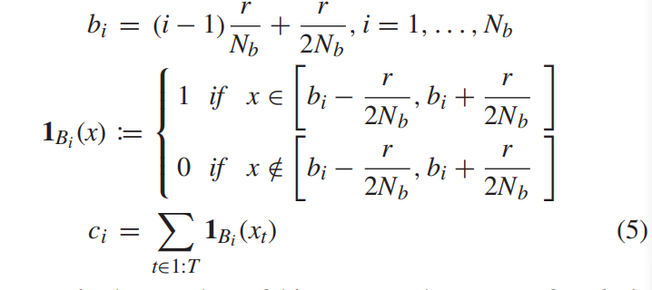

Determining number of Hidden States with iterative k-means
Select initial centroid
evenly given the appliance power profile x by
fit HMM for multi-state appliances without specifying number of state.
Histogram analysis
Algorithm 1 and 2,
Fig 3 and 4.
Copy paste fonts. Choose the only option to retain t
Initial centroid
can be placed closer to the dominant power level by:

Slide 16
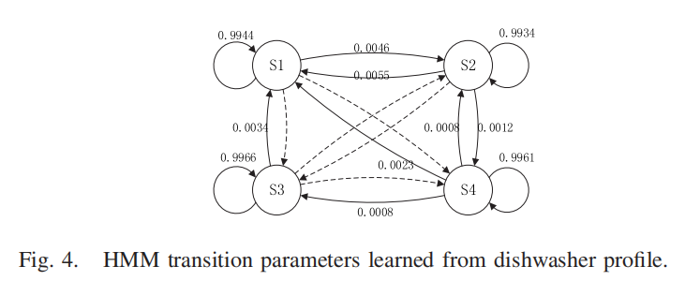
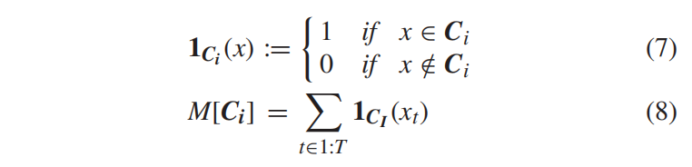

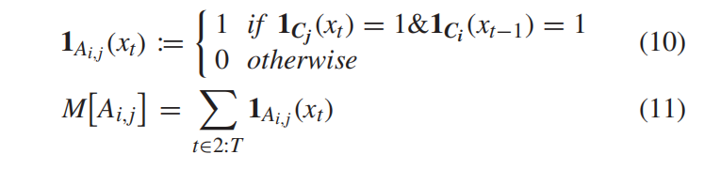

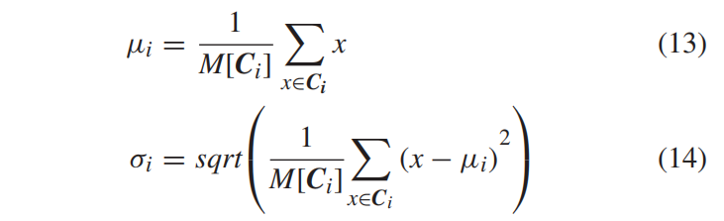
Fitting HMM parameters for individual appliance

Slide 17
Probabilistic approach to solve NILM
/03
Appliance Level Modelling importance,
NILM signature,

Slide 18
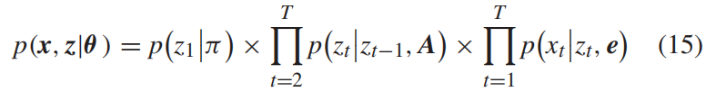
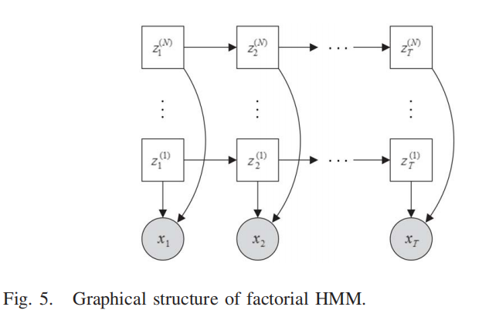
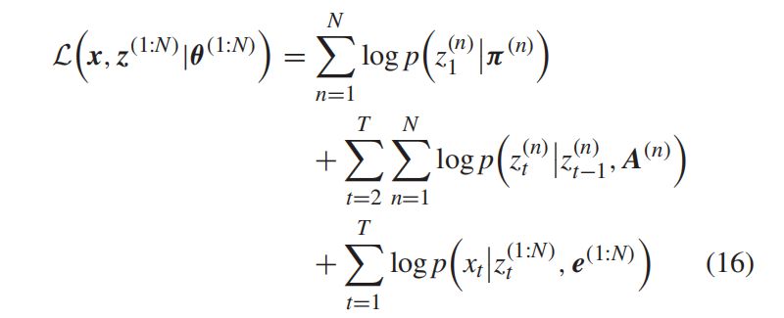

Modelling NILM as FHMM
They are also very time consuming and do not facilitate real-time implementation.

Slide 19
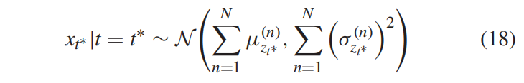
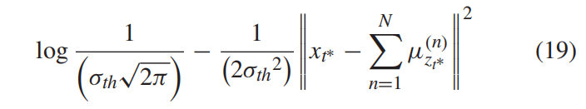
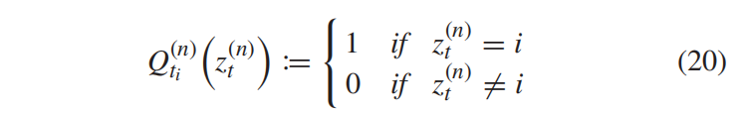
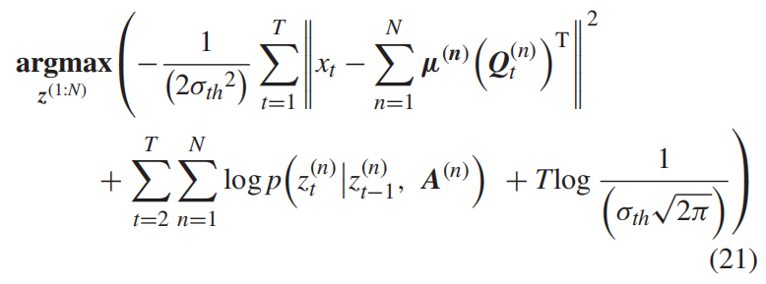
Approximate solver for NILM
Text

Slide 20
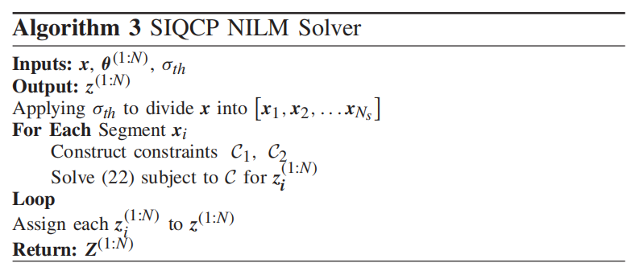
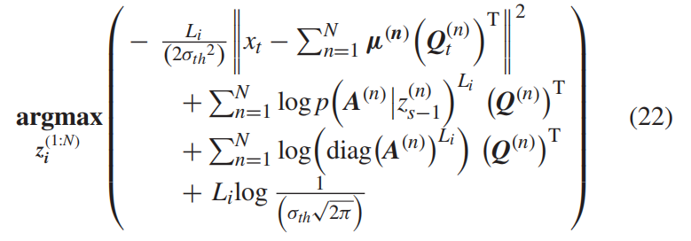
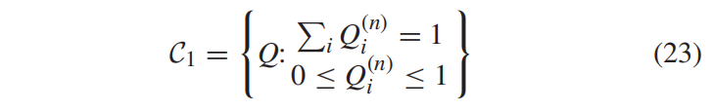
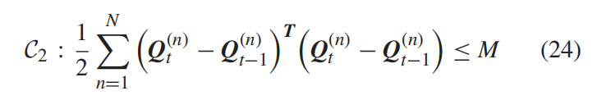
Segment-wise integer quadratic constraint programming
NILM solver.

Slide 21
NILM framework
/04
Appliance Level Modelling importance,
NILM signature,

Slide 22
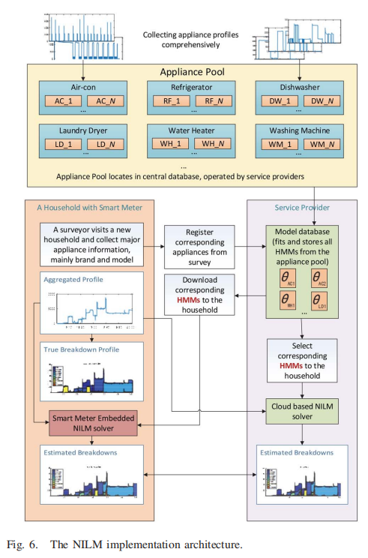

Slide 23
Simulation and Evaluation
/05
Appliance Level Modelling importance,
NILM signature,

Slide 24

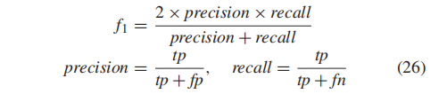
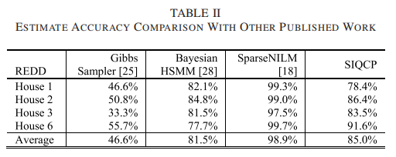
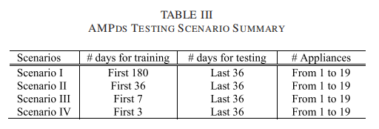
Evaluation
REDD dataset
AMPds
…text
…text

Slide 25
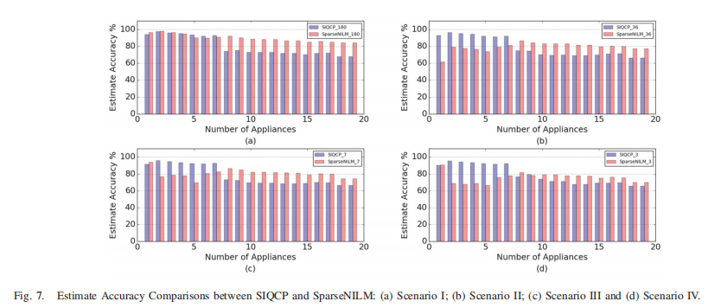
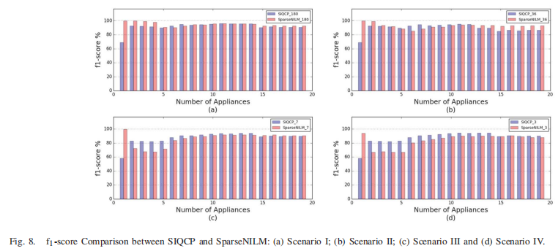
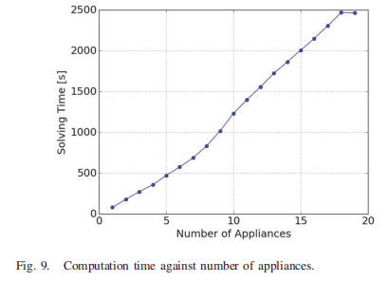
Experimental data
%

Slide 26
Conclusion
/06
Appliance Level Modelling importance,
NILM signature,

Slide 27
继往开来
80%
20%
Result
Future
a complete NILM framework with fitting algorithm and NILM solver based on SIQCP
there is still plenty of room for improvement
Simulation .ideal for new household
trade-off

Slide 28
github
http://github.com/WilsonKong/siqpnilm
http://redd.csail.mit.edu/
http://ampds.org/
http://nilm.ca/
Recreate
Innovate

Slide 29
Inspiration for Research and Engineer
/xx
Appliance Level Modelling importance,
NILM signature,

Slide 30
inspiration
mul parameters
pratical constraint
voltage,current.
power, real, active,factor.
signature.
COST deployment.
mul modelling
Target
not always signal processing,
maybe data mining.
many application scenarios.

Slide 31
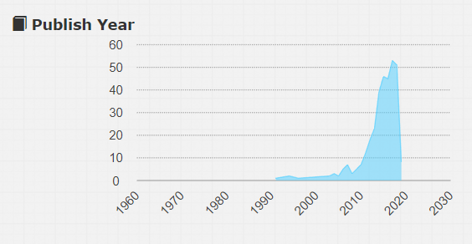
inspiration
keywords:non-intrusive load monitoring
data from https://www.acemap.info

Slide 32
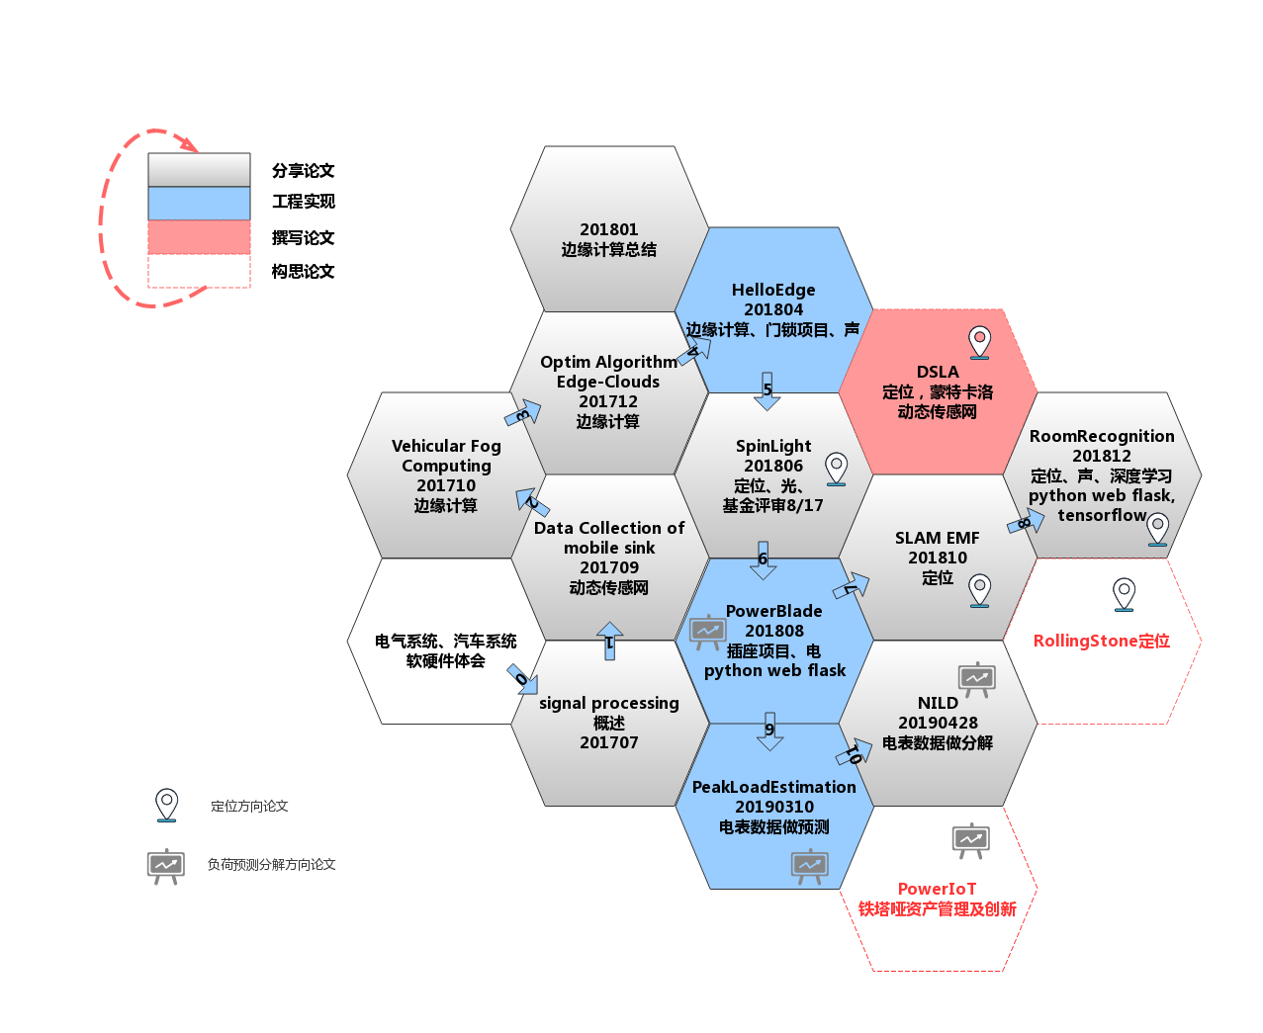
research circle

Slide 33
Thanks. Research based on Projects.
Thanks
wang.david.wei@scu.iot

